Slide 1
Announcements
All assignments need to be turned in by Monday, April 27th
Unless it is a lab you are making up on Tuesday 28th and/or Wednesday 29th
As a reminder - the makeup labs are for ones you missed and you must inform me in advance

Slide 2
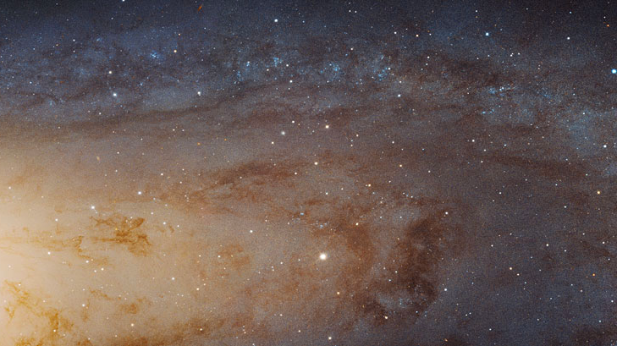
Galaxy Morphology

Slide 3
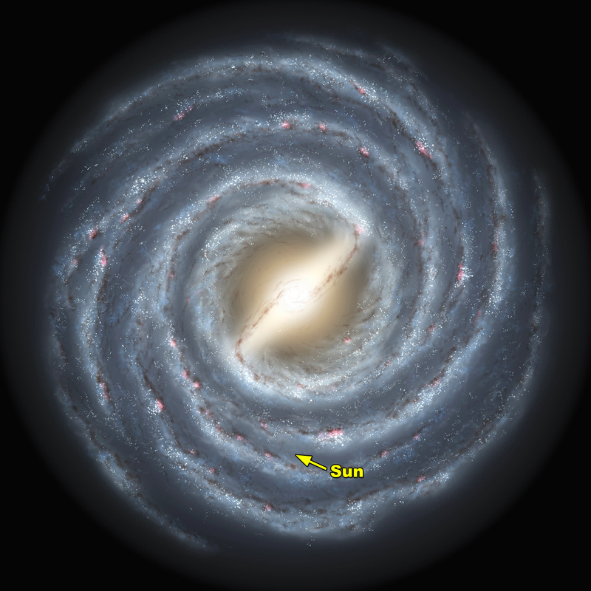
Galaxies
A gravitationally bound collection of stars, planets, gas, dust, and dark matter
Millions, billions, or even trillions of stars
The Milky Way →

Slide 4
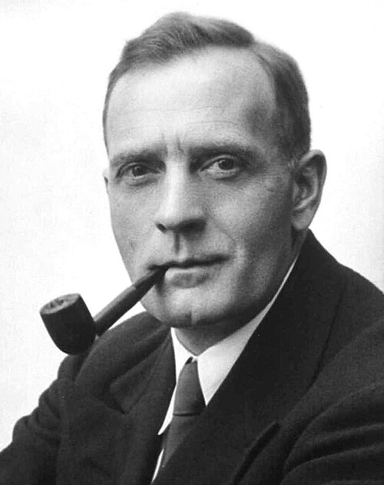
Edwin Hubble
In 1919, Edwin Hubble used the Cepheid Period-Luminosity Relationship (3 labs ago) to prove the universe was vastly bigger than just the Milky Way
And that many of the we observed nebulae were actually distant galaxies - of which the Milky Way was just one
In 1926, he created the classification scheme still largely used today (today’s lab)
In 1929, he proved that galaxies are moving away from us - (next week’s lab)

Slide 5
Three Types of Galaxies

Slide 6
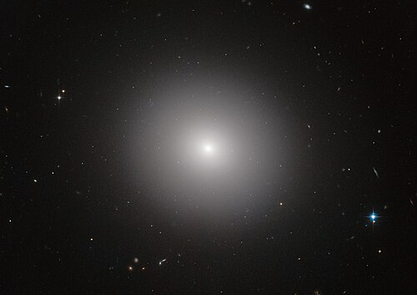
Elliptical
Old, with old, small stars
Mostly made up of globular clusters
Very little (if any) new star formation
How they form is still an area of active research
Likely either formed from very rapid star formation, long ago
Or formed from the mergers of other galaxies
Or maybe both

Slide 7
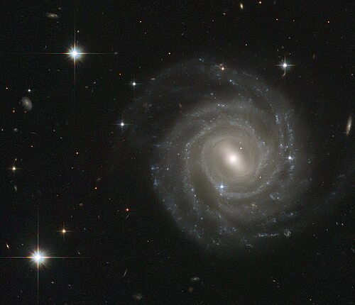
Spiral
The stereotypical galaxy - like the Milky Way
A central “bulge” surrounded by spiralling arms
The arms are where there is active star formation
A spherical “halo” of dark matter
May be a “barred spiral” - like the Milky Way
Or just have the arms come right out of the middle

Slide 8
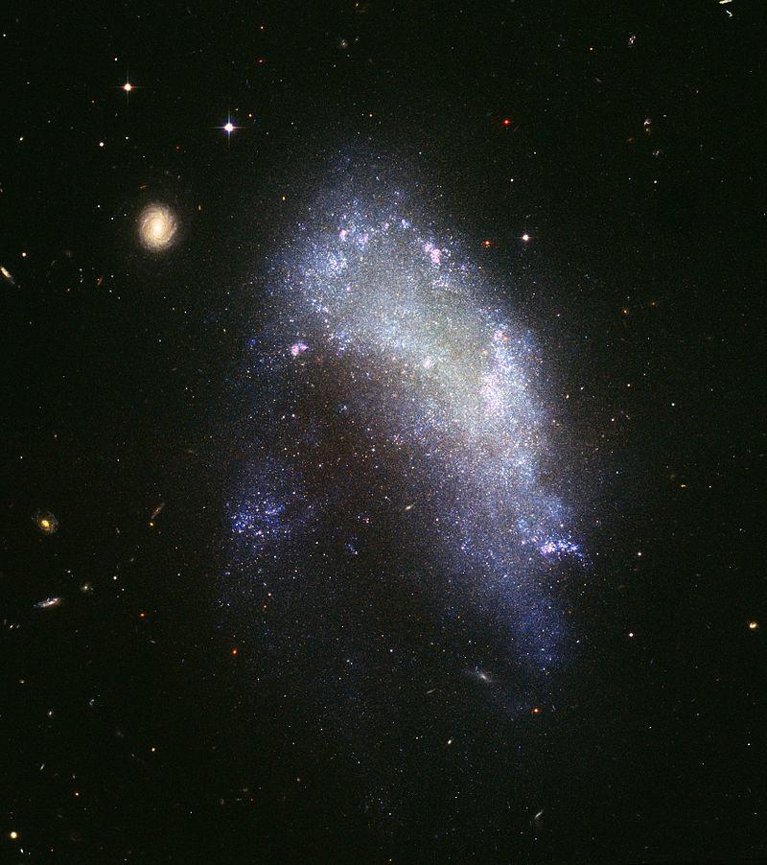
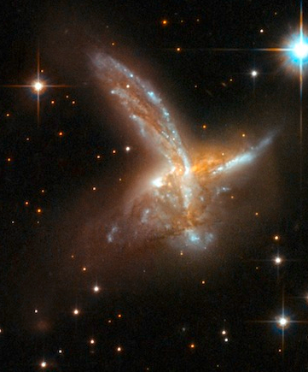
Irregular
Don’t really have a set shape
Formed by other galaxies colliding
Eventually, they will likely reform into elliptical galaxies
Usually (but not always) small

Slide 9
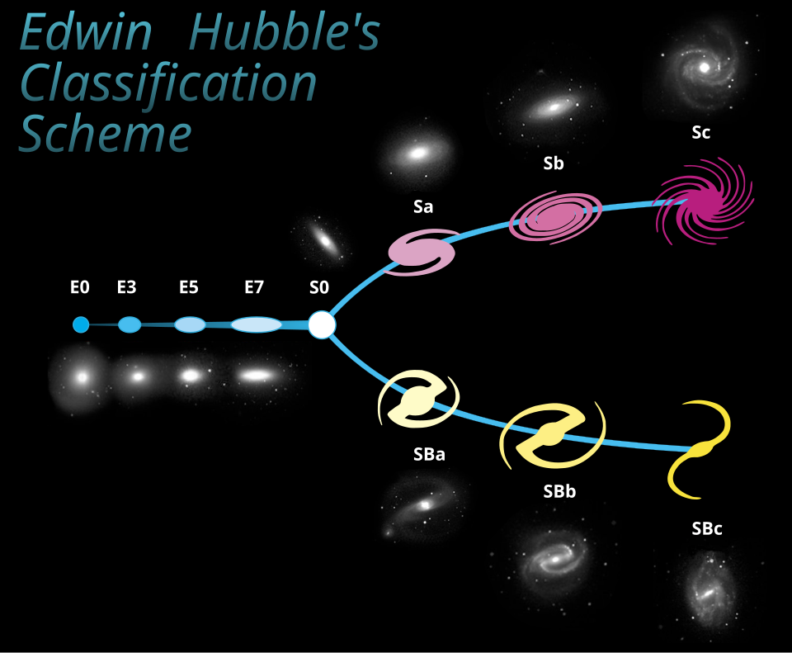
The Classification Scheme
Elliptical
Go from E0 (a sphere) to E7 (oblong)
Spiral
Split into 2 subtypes
S, which is the spiral arms coming out of the galaxy’s core
And SB, which has a “bar” through the middle of the galaxy which the arms come off of
Both are broken down into a, b, and c, which have to do with the size of the galactic core
Irregular
Neither Elliptical or Spiral
Probably started as one of the others, but was disrupted by interactions with other galaxies

Slide 10
Today
Very simple lab - look at pictures, then classify them
Go to http://windhorst114.asu.edu/galmorph.html (link on Canvas page)
Work down the list, classifying each galaxy as you go
Make sure to justify each answer - accuracy is important, but I will be more concerned with the justifications when grading
Look at shape, but color can sometimes be helpful too
Redder galaxies are older, and so have less star formation
Bluer are younger, and have more active star formation
Answer questions 1-7 after classifying the galaxies and make sure to do the conclusion/summary on the bottom of page 5

